Slide 1
DATA VISUALIZATION
16/03/2022
Aggregation and Summarization
Understanding the concept of Pixel
Raster to vector conversions

Slide 2
AGGREGATION AND SUMMARIZATION
In the event that too much data is present, it is often useful to group data points based on their similarity in value and/or position and represents the group by some smaller amount of data.
This can be as simple as averaging the values.
Data aggregation is the process where data is collected and presented in a summarized format for statistical analysis and to effectively achieve business objectives.

Slide 3
CONTD.
Data aggregation is vital to data warehousing as it helps to make decisions based on vast amounts of raw data.
Data aggregation provides the ability to forecast future trends and aids in predictive modeling. Effective data aggregation techniques help to minimize performance problems.
Aggregation provides more information based on related clusters of data such as an individual’s income or profession.
For example, a store may want to look at the sales performance for different regions, so they would aggregate the sales data based on region.

Slide 4
CONTD
Types of aggregation with mathematical functions:
Sum—Adds together all the specified data to get a total.
Average—Computes the average value of the specific data.
Max—Displays the highest value for each category.
Min—Displays the lowest value for each category.
Count—Counts the total number of data entries for each category.

Slide 5
SUMMERIZATION
The term Data Summarization refers to presenting the summary of generated data in an easily comprehensible and informative manner.
Presenting the raw data (the data that was generated which is essentially the entire repertoire of datasets- individual measurements) is not practical in many cases.

Slide 6
CASE STUDY
For example, an epidemiological study that involved blood glucose measurements from lakh samples, or human genome (the entire human genome if printed, would occupy 130 volumes and take 95 years to read).
Presenting such complex data would need several printed pages, and convey no easily comprehensible information.
However, note that the raw data should not be dismissed as useless; the data should be carefully archived either in physical form or in online archival tools that generate a Digital Object Identifier (DOI) such as LabArchives (https://www.labarchives.com/) and should be available for inspection at any time.

Slide 7
CONTD
A carefully chosen summary of raw data would convey many trends and patterns of the data in an easily accessible manner. The term ‘data mining’ refers to exactly this; extracting meaningful information from the raw data.
For example, what are the genes in the human genome? The way data is presented is very important, although often overlooked aspect in statistics.
Data summarization comes much before any statistical tests; indeed choosing an appropriate statistical test depends on the general trends of the data revealed in the summarization step.

Slide 8
Tabular Summarization
In general, data can be summarized numerically as a table (tabular summarization), or visually as a graph (data visualization). A raw dataset can be summarized as a table by grouping the individual measurements (elements of data set) into various, appropriately labeled bins.
Such a table could instantaneously convey the patterns of the data in an easily accessible manner.
Examples of such tabular summarization include Empirical Frequency Distribution, Cumulative Frequency Distribution, Relative Frequency Distribution, contingency table, and a table containing values of various descriptive statistical assessments as explained in a later module.

Slide 9
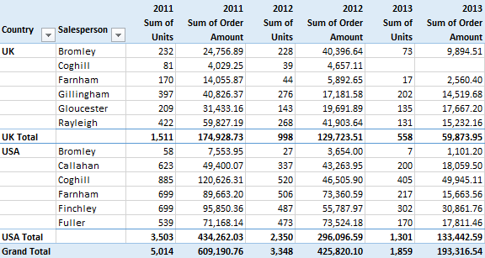

Slide 10
Graphical Summarization of Data
On the other hand, these tables can also be presented, perhaps in a more accessible manner, visually through graphs.
As the apophthegm goes, “a picture is worth a thousand words”, a carefully chosen graph style could summarize the whole data effectively such a manner that an investigator spends as little time as possible to see the general trends.
Examples include stem-and-leaf diagrams, histograms, Ogives, time-series line graphs, column/bar graphs, box-and-whisker plots, pie charts, heatmaps, tree-representations, network graphs, bubble graphs, contour plots, area charts, scatterplots (also called dot plots), and so on.

Slide 11
Contd.
Many of these chart types have 3-dimensional variants as well which are used if values of three variables are simultaneously plotted.
Choice of table or graph for data summarization is largely a personal option. However, the choice of appropriate tables or graphs depends upon the level of measurements mentioned in the previous module. The below table may be referred to as a rule of thumb to decide the appropriate summarization style.

Slide 12
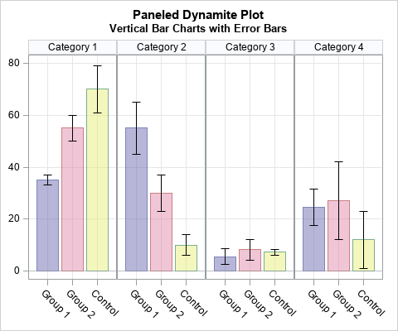

Slide 13
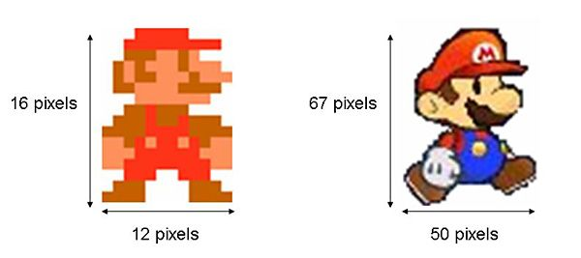
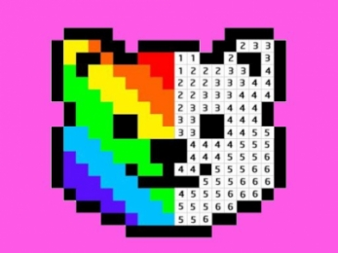
Understanding Pixels
Pixel is a computer term for "picture element". The ideal is that each pixel is only one color, and color is the detail in the image.

Slide 14
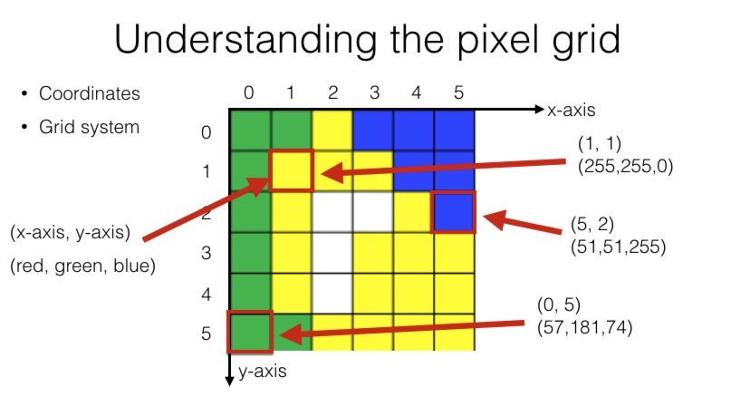

Slide 15
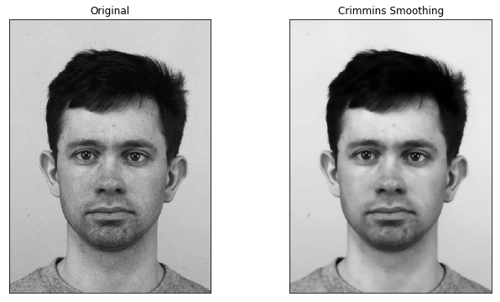
Smoothing
Smoothing is used to reduce noise or to produce a less pixelated image. Most smoothing methods are based on low-pass filters, but you can also smooth an image using an average or median value of a group of pixels (a kernel) that moves through the image.

Slide 16
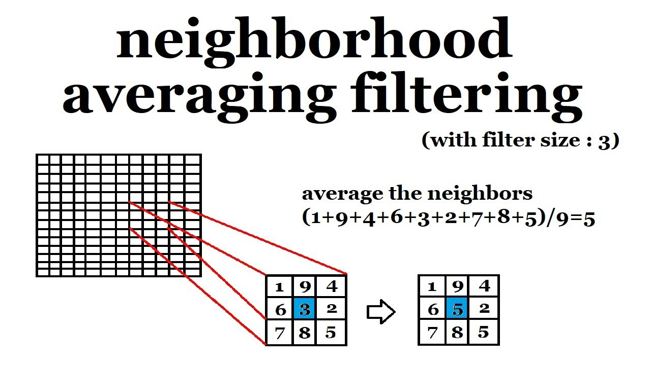

Slide 17
Filtering
Filtering is a technique for modifying or enhancing an image.
For example, you can filter an image to emphasize certain features or remove other features.
Image processing operations implemented with filtering include smoothing, sharpening, and edge enhancement.

Slide 18
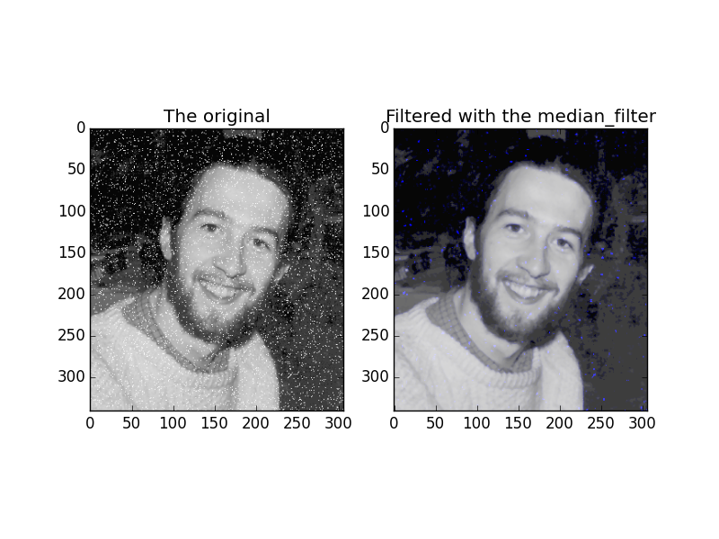
Contd.

Slide 19

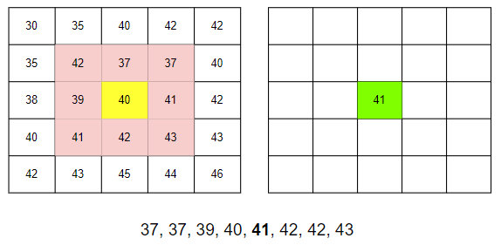

Slide 20
Raster to Vector Conversion
In computer graphics, objects are typically represented by sets of connected, planar polygons (vertices, edges, and triangular or quadrilateral patches), and the task is to create a raster (pixel level) image representing these objects, their surface properties, and their interactions with light sources and other objects.
Raster: In computer graphics and digital photography, a raster graphic represents a two-dimensional image as a rectangular matrix or grid of square pixels, viewable via a computer display, paper, or another display medium.
Vector graphics, as a form of computer graphics, is the set of mechanisms for creating visual images directly from geometric shapes defined on a Cartesian plane, such as points, lines, curves, and polygons.

Slide 21
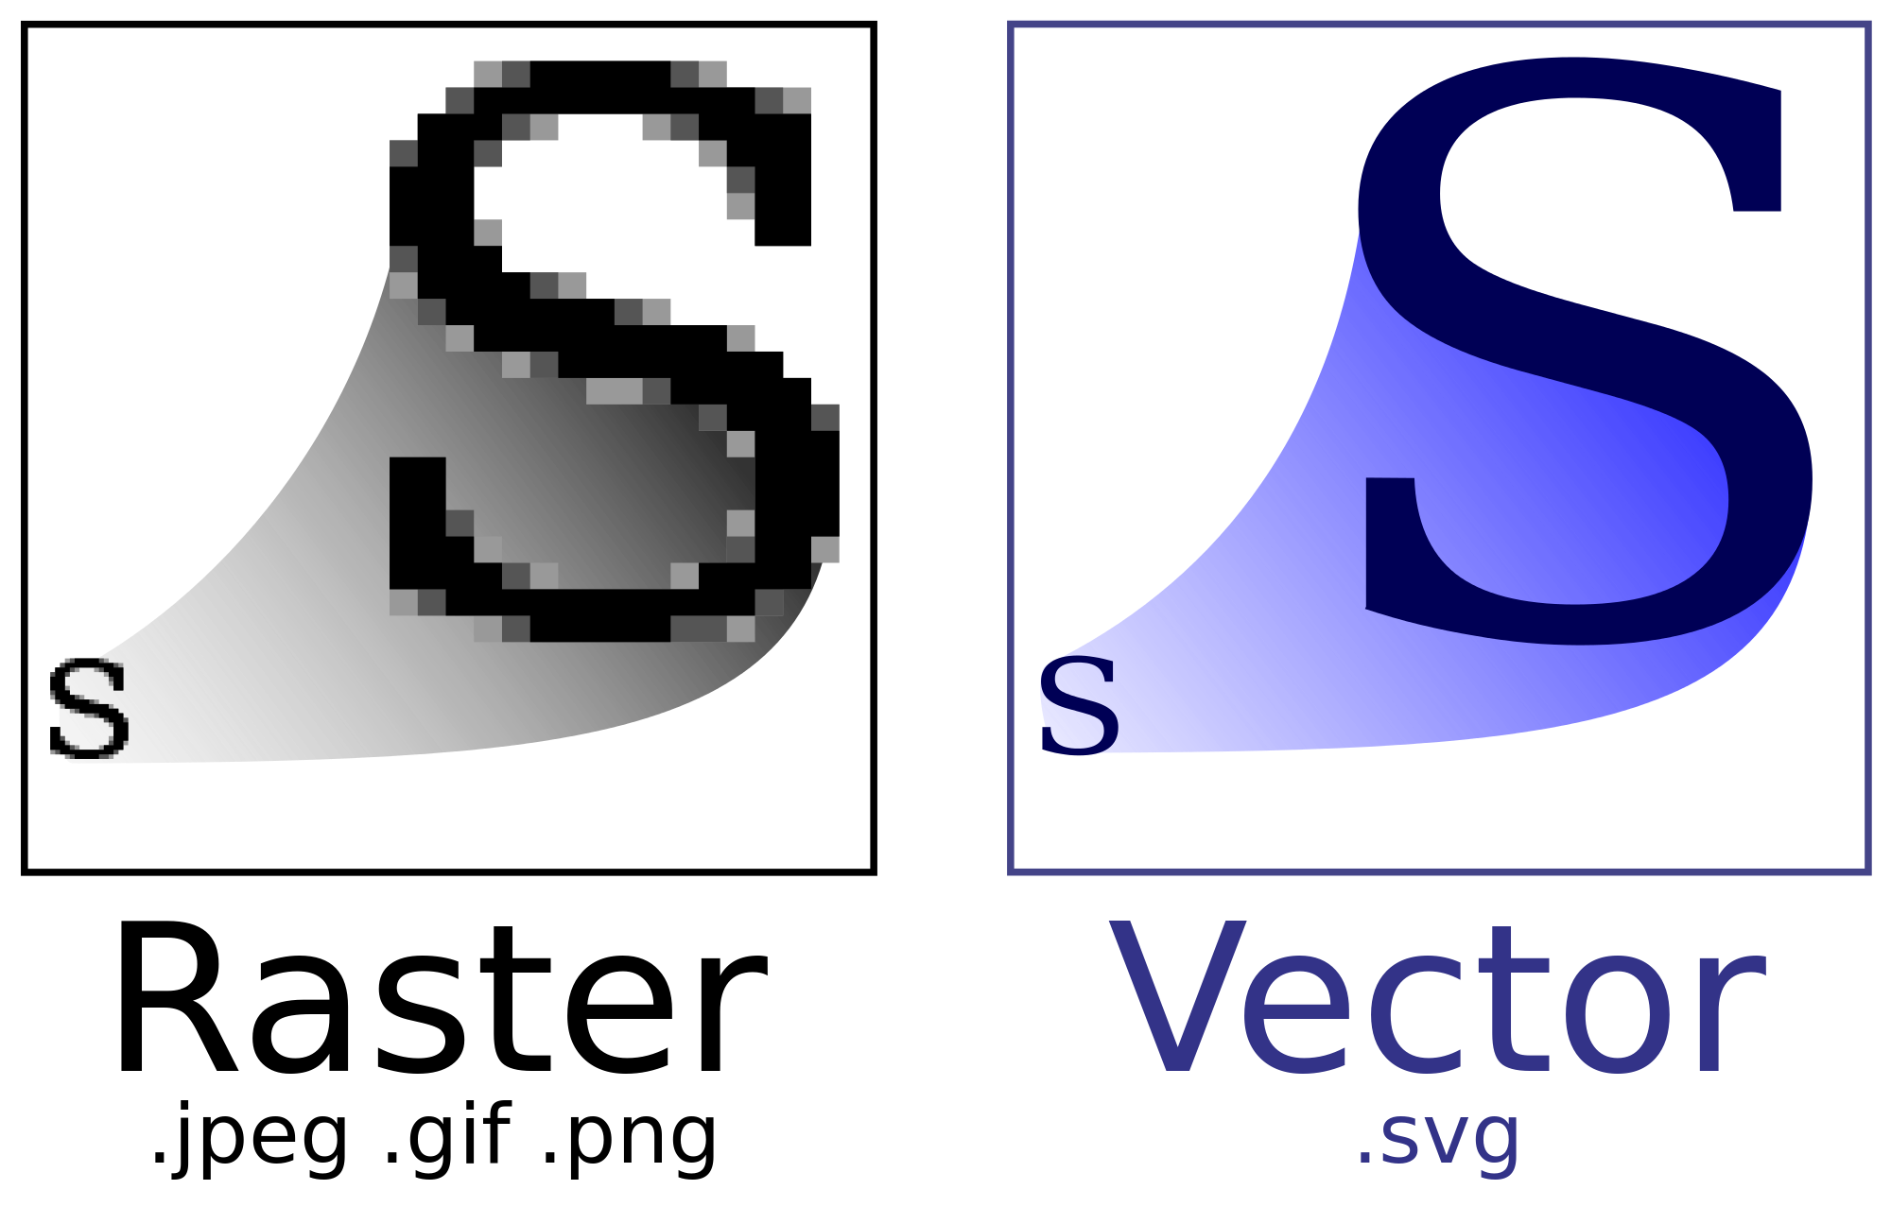
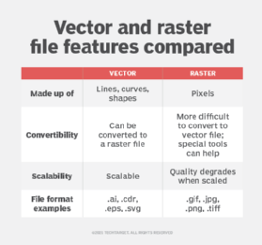
Raster vs Vector

Slide 22
Reasons for Transformation
Reasons for doing this might include:
• Compressing the contents for transmission. A vertex and edge list is almost always more compact than a raster image.
• Comparing the contents of two or more images. It is generally easier and more reliable to compare higher-level features of images, rather than their pixels.
• Transforming the data. Affine transformations such as rotation and scaling are easier to apply to vector representations than to raster.
• Segmenting the data. Isolating regions by drawing boundaries around them is an effective method for interactive exploration and model building.

Slide 23
Principal Component Analysis
Principal Component Analysis, or PCA, is a dimensionality-reduction method that is often used to reduce the dimensionality of large data sets, by transforming a large set of variables into a smaller one that still contains most of the information in the large set.
Reducing the number of variables of a data set naturally comes at the expense of accuracy, but the trick in dimensionality reduction is to trade a little accuracy for simplicity.

Slide 24
Contd.
Because smaller data sets are easier to explore and visualize and make analyzing data much easier and faster for machine learning algorithms without extraneous variables to process.
So to sum up, the idea of PCA is simple — reduce the number of variables of a data set, while preserving as much information as possible.

Slide 25
